Slide 1
UNIT III.Overview of medical Mycology Opportunistic Mycoses
Sweta Sushmita Tigga
Lecture- M.Sc Microbiology, Sem-III
Department of Microbiology,
DSPMU, Ranchi

Slide 2
Opportunistic Mycoses
An Opportunistic organisms is generally harmless in its normal environment but becomes pathogenic in a compromised host.
Compromised host is seriously debilitated and has lowered resistance to infection.
There are many causes of this condition-
malnutrition
Cancer
Leukemia or another infectious disease
Trauma from surgery or injury

Slide 3
Opportunistic Mycoses
The most important opportunistic mycoses include-
Systemic Aspergillosis
Candidiasis
Pneumocystis pneumonia or Pneumocystis carinii pneumonia (PCP)

Slide 4
Aspergillosis
Aspergillus is omnipresent in nature, being found wherever organic debris occurs.
Aspergillus fumigatus is the usual cause of aspergillosis.
A. flavus is the second most important species, particularly in immunosuppressed patients.

Slide 5
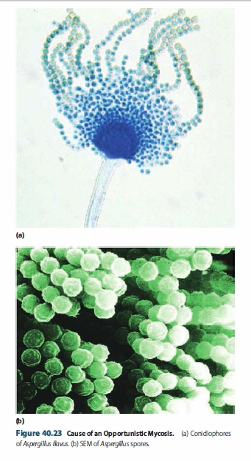
Aspergillosis
The major portal of entry for Aspergillus is the respiratory tract.
Inhalation of conidiospores can lead to several types of pulmonary aspergillosis. One type is allergic aspergillosis.
Infected individuals may develop an immediate allergic response and suffer typical asthmatic attacks when exposed to fungal antigens on the conidiospores.
In bronchopulmonary aspergillosis the major clinical manifestation of the allergic response is a bronchitis resulting from both type I and type III hypersensitivities

Slide 6
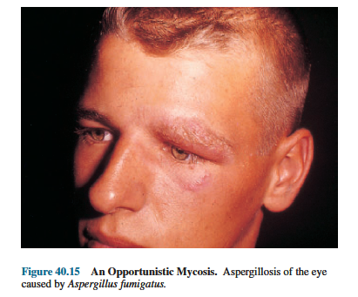
Aspergillosis
Although tissue invasion seldom occurs in bronchopulmonary aspergillosis, Aspergillus often can be cultured from the sputum.
A most common manifestation of pulmonary involvement is the occurrence of colonizing aspergillosis, in which Aspergillus forms colonies within
the lungs that develop into “fungus balls” called aspergillomas.

Slide 7
Aspergillosis
Laboratory Diagnosis- Either by direct examination of pathological specimens or by isolation and characterization of the fungus.
Treatment- itraconazole.

Slide 8
Candidiasis
Candidiasis is the mycosis caused by the dimorphic fungus Candida albicans.
Oral candidiasis or thrush, is a common disease in newborns. It is seen as many small white flecks that cover the tongue and mouth. At birth, newborns do not have a normal microbiota in the oralpharyngeal area. If mother’s vaginal area is heavily infected with C. albicans, the upper respiratory tract of the newborn becomes colonized during passage through birth canal.
Thrush occurs because growth of C. albicans cannot be inhibited by the other microbiota. Once the newborn baby has developed its own normal oropharyngeal microbiota, thrush becomes uncommon.

Slide 9
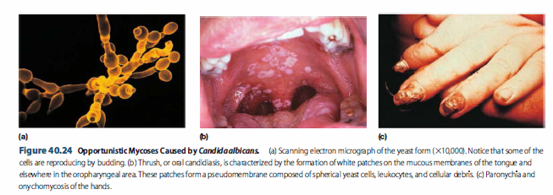
Candidiasis

Slide 10
Candidiasis
Paronychia and Onychomycosis are associated with Candida infections of the subcutaneous tissues of the digits and nails, respectively
Diagnosis-
This fungus is a frequent secondary invader in diseased hosts
A mixed microbiota often found in the diseased tissue
Treatment –
Cutaneous lesions can be treated with topical agents such as sodium caprylate, sodium propionate, gentian violet, nystatin, miconazole and trichomycin.
Ketoconazole, amphotericin B, fluconazole, itraconazole and flucytosine also can be used for systemic candidiasis.

Slide 11
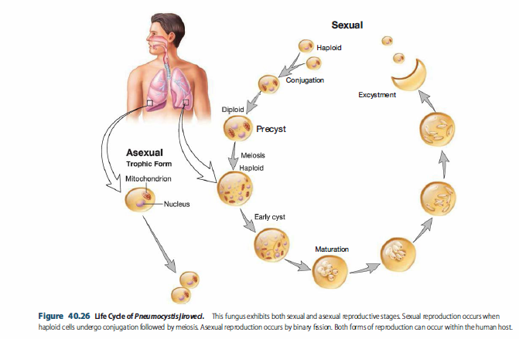
Pneumocystis pneumonia or Pneumocystis carinii pneumonia (PCP)

Slide 12
Pneumocystis pneumonia or Pneumocystis carinii pneumonia (PCP)
Pneumocystis jiroveci is a fungus found in the lungs of a wide variety of mammals.
The disease that this fungus causes has been called Pneumocystis pneumonia or Pneumocystis carinii pneumonia (PCP).
Its name was changed to Pneumocystis jiroveci in honor of the Czech parasitologist, Otto Jirovec, who first described this pathogen in humans.
PCP now stands for Pneumocystis pneumonia.

Slide 13
Pneumocystis pneumonia or Pneumocystis carinii pneumonia (PCP)
Serological data indicate that most humans are exposed to P. jiroveci by age three or four.
However, PCP occurs almost exclusively in immunocompromised hosts. Extensive use of immunosuppressive drugs and irradiation for the treatment of cancers and following organ transplants accounts for the formidable prevalence rates for PCP.
This pneumonia also occurs in premature, malnourished infants and in more than 80% of HIV positive patients who have progressed to AIDS

Slide 14
Pneumocystis pneumonia or Pneumocystis carinii pneumonia (PCP)
Both the organism and the disease remain localized in the lungs-even in fatal cases. Within the lungs, P. jiroveci causes the alveoli to fill with a frothy exudate.
Laboratory diagnosis - Pneumocystis pneumonia can be made definitively only by microscopically demonstrating the presence of the microorganisms in infected lung material or by a PCR analysis.

Slide 15
Pneumocystis pneumonia or Pneumocystis carinii pneumonia (PCP)
Treatment is by means of oxygen therapy and either a combination of trimethoprim and sulfamethoxazole, atovaquone or trimetrexate.
Prevention and control - with drugs, such as fluconazole, in susceptible persons.

